Slide 1
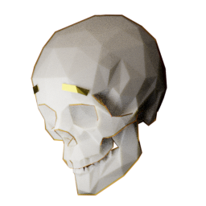
Friendly Skeleton Games
Mason
Leslie
Dani
Natalie
Alec
Cassandra
-Programmer
-Lead designer
-Programmer
-Programmer
-Audio
-Producer
-Artist
-Writer
Notes:
Logo goes in the top right corner when it is ready.

Slide 2
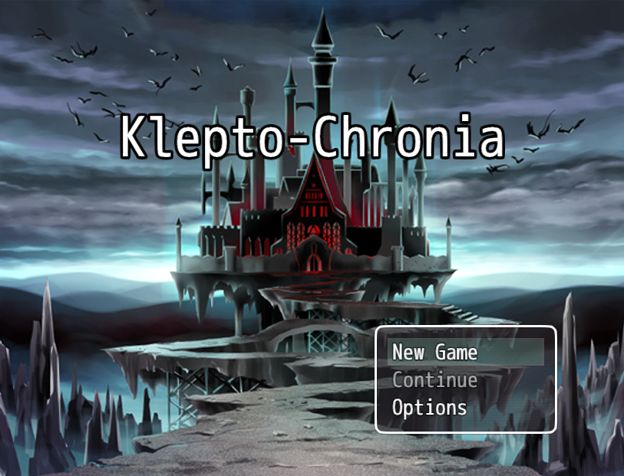
Notes:
Klepto-Chronia is a puzzle stealth game

Slide 3

Unique Feature - Time Stop
Notes:
Flip past this slide before the gif loops.

Slide 4
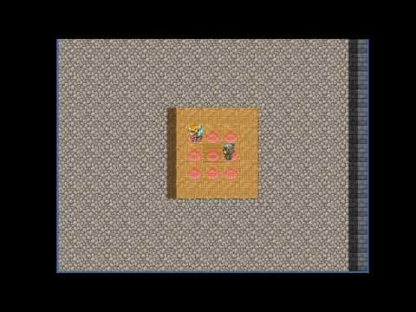
Time Stop Demo

Slide 5
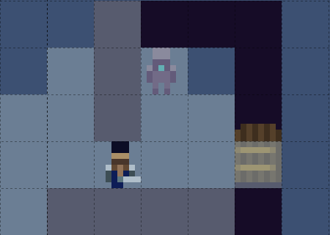
Time Stop - Simple Uses

Slide 6
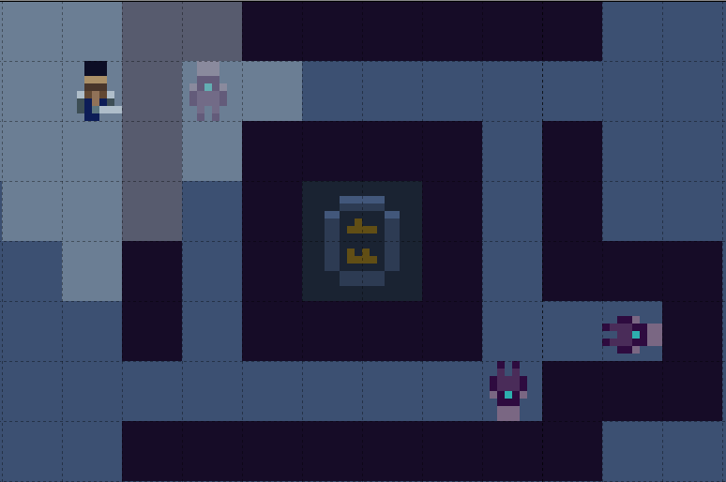
Time Stop - More Advanced

Slide 7
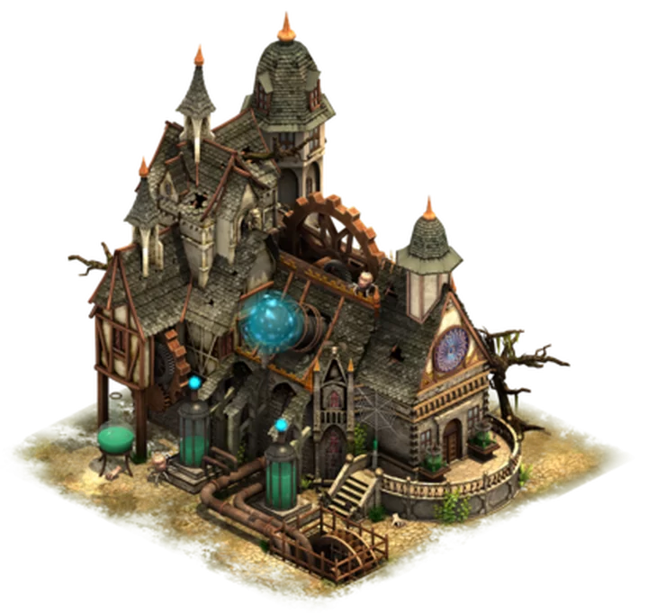
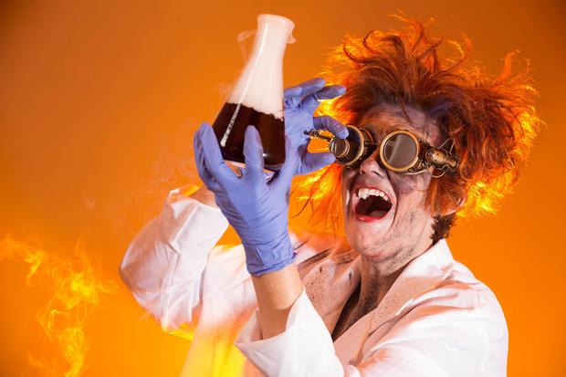
Setting
Notes:
Set in the lab of Dr. Ology, a reclusive science prodigy from the past.
Lab is full of wondrous, but clunky inventions for his time

Slide 8
Player Role
Time travelling thief from the future.
Can freeze time to solve puzzles and avoid danger.
Trying to steal a time travel device to return to the future.

Slide 9
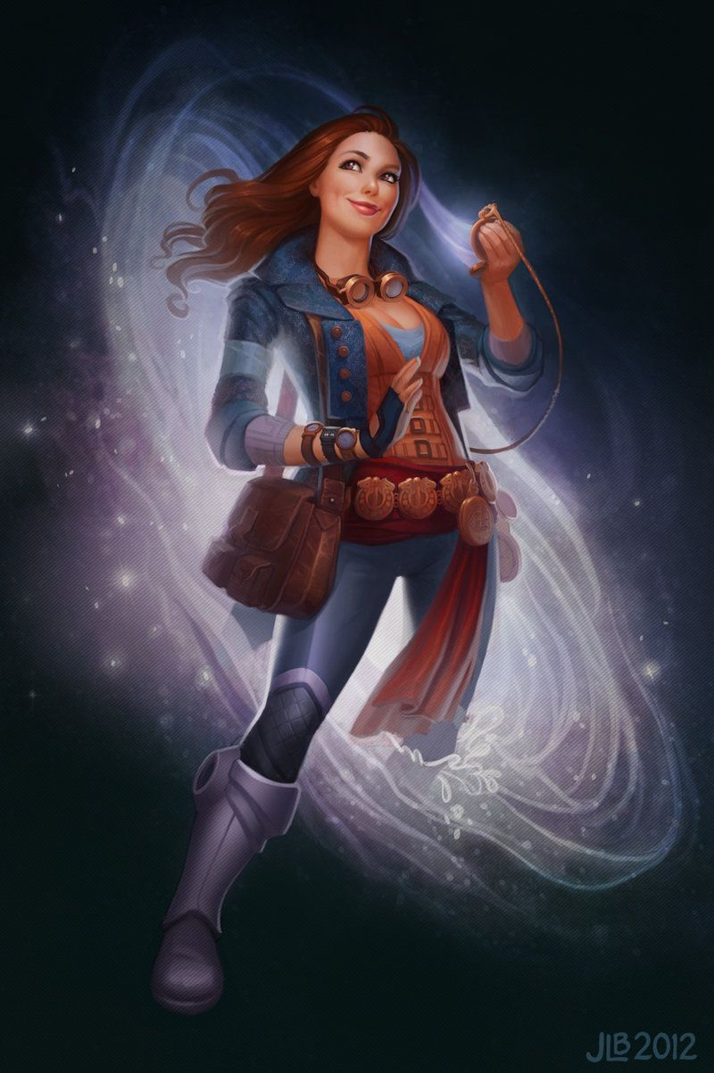
Main Character: Amelia
The player character.
Easily flustered.
Socially oblivious.
Sarcastic.

Slide 10

Sidekick: Delphi
NPC, Narrator, Amelia’s Partner
Charming.
Teasing.
Helpful

Slide 11

Main Antagonist: Dr. Ology
Mad scientist archetype
Owner of the mansion
Close to unraveling time travel

Slide 12
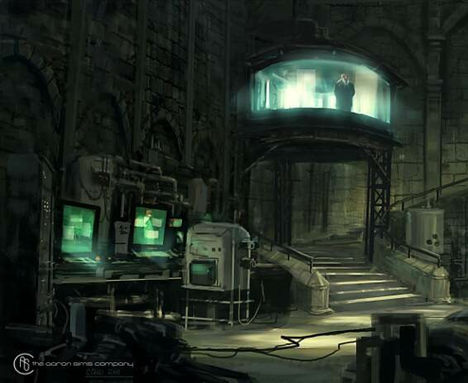
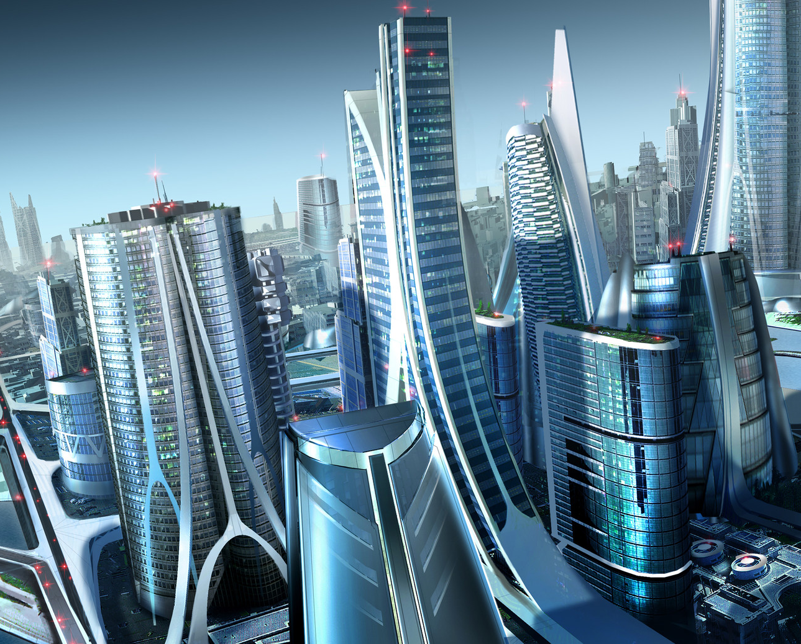

Core Game Objectives
Explore lab
Find time machine
Return to future
Notes:
Traverse through Dr. Ology’s high tech lab.
Find time device relic
Return to the future

Slide 13
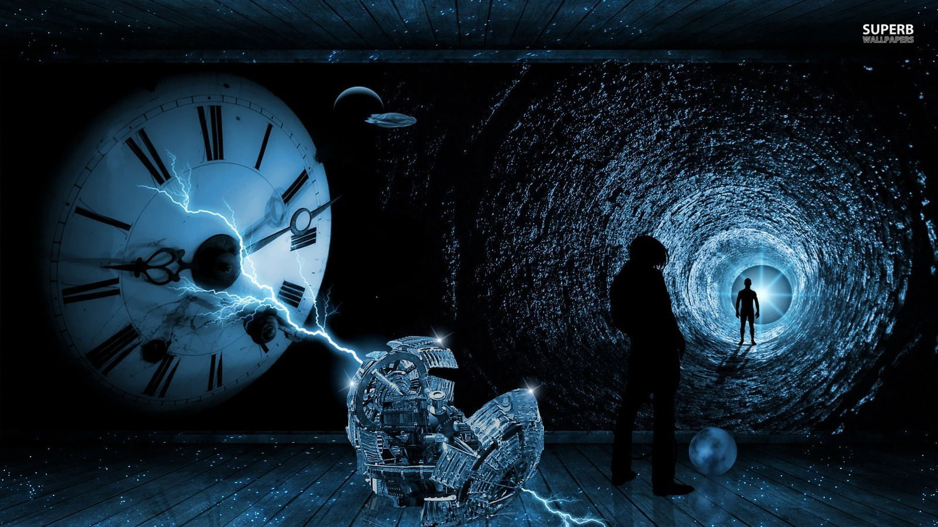
Target Audience
Fans of :
Sci-Fi
Retro-Futurism
Puzzles

Slide 14
So what about the actual “game” part of this?

Slide 15
Game Mechanics
Walk up, down, left, and right
Time stop
Buttons
Guards
Moving blocks
Collectibles

Slide 16
Game Dynamics
Buttons
Time stop
Enemies and traps
Set checkpoints
Reset to a checkpoint
Collectibles
Notes:
Buttons can be stepped on for an effect.
Time freeze can freeze the state of affected objects.
Enemies and traps can reset player progress if player is caught.
Player can save at set checkpoints placed throughout the game.
Time reverse can reset to a checkpoint if player gets stuck.
Player collects time crystal shards to unlock other areas and progress through the game.

Slide 17
Game Aesthetics
Vulnerability - lack of attacks
Empowerment - abilities
Satisfaction - puzzles
Curiosity - setting
Humor - characters
Notes:
Vulnerability: The player has no way to fight back and must outsmart confrontation. This ties in with:
Empowerment: The player’s abilities are fantastical and allow the player to overcome obstacles.
Satisfaction: Puzzles are hard but rewarding.
Curiosity: The setting is intricate and interesting with lots of hidden stuff.
Humor: Interactions between characters, as well as the PC’s sarcasm/obliviousness.

Slide 18
Development Risks
Big scope potential
Time stopping requires a lot of considerations
Notes:
Big scope potential
Lots of potential spriting
Time stopping is hard
What happens when something is frozen / unfreezes
Have to balance it so it is fun to use and easy to understand.

Slide 19
Question Time!

Slide 20
Sources
Time Traveler for IFX by JessiBeans on DeviantArt - https://www.deviantart.com/jessibeans/art/Time-Traveler-for-IFX-338336581
Sci-Fi Fantasy character concepts by CpnTuttle - https://imgur.com/6hgOiKm
Time Travel Wallpaper by WallpaperAccess - https://wallpaperaccess.com/time-travel
Dio time stop gif from Jojo’s Bizarre Adventure: Stardust Crusaders
Tardis - Dr. Who
Title Screen - RPG Maker MV
8x8 Tileset by Soundlust - https://opengameart.org/content/8x8-tileset-by-soundlust
Professor E. Gadd - Luigi’s Mansion
SciFi Futuristic City - Rob Brown - https://www.artstation.com/artwork/xBglY

Slide 21
Sources continued
Laboratory Concept Art - Aaron Sims Creative - https://www.artstation.com/artwork/oO8GDO
Mad Scientist’s Lab - Forge of Empires - https://forgeofempires.fandom.com/wiki/Mad_Scientist%27s_Lab
Mad scientist - https://media.istockphoto.com/photos/mad-scientist-picture-id169944301?k=20&m=169944301&s=612x612&w=0&h=l-QPi_wQkw7Ow_uqw5R_Fb1sLaF31jQLmKrchLvKBQY=

